Slide 1


Analysis of Rubik’s Cube Solving Algorithms
Minor Project 1
Garvit Khurana Tanya Malhotra Utkarsh Gupta Vanshaj Goel
Mentor – Prof. Bikram Pratim Bhuyan

Slide 2
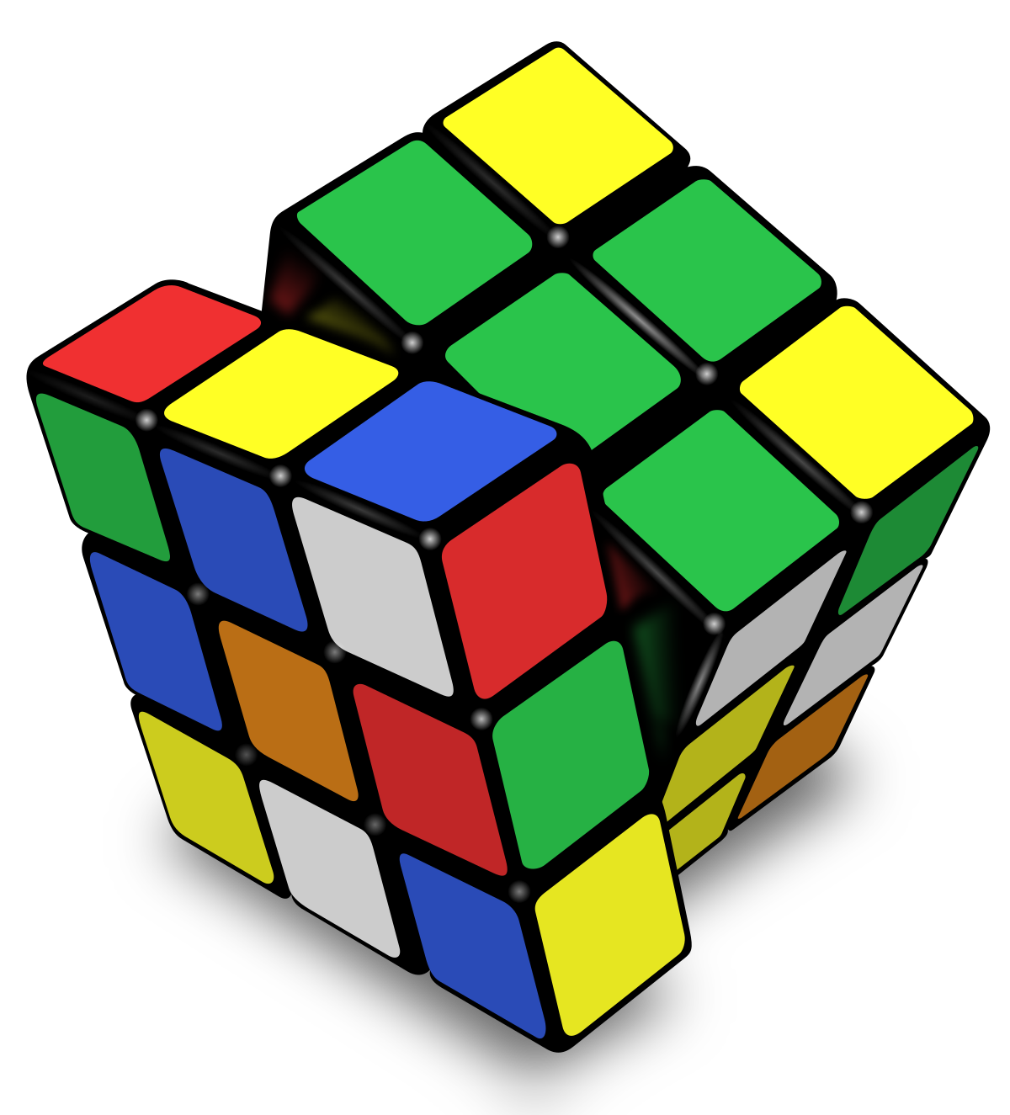
Index
2
S. No. | Content | Slide No. | Time Stamp | Narrated by
1 | Introduction | 3 – 5 | 00:26 | Tanya Malhotra
2 | Motivation | 6 | 03:06
3 | Related Work | 7 | 03:54 | Garvit Khurana
4 | Proposed Method | 8 – 11 | 05:35 | Utkarsh Gupta
5 | Methodology | 12 | 07:48 | Vanshaj Goel
6 | Plan of Work | 13 | 08:38
7 | References | 14 | 09:30 | -
8 | Team Details | 15 | 09:36
Notes:
00:26
03:06
03:54
05:35
07:50
08:42
09:35
09:40

Slide 3
Introduction
3
History of a Rubik’s Cube
The Rubik’s Cube or a Magic Cube is a 3 – dimensional combination puzzle.
It was invented by a Hungarian sculptor and professor of architecture named Ernő Rubik in the year 1974.
Knowing a Rubik’s Cube
A 3x3x3 Rubik’s cube has six faces with eight corners, twelve edges and six centre pieces.
Each of the faces have one of these six colours – white, yellow, green, blue, red and orange.
There are three layers – Top, Middle and Bottom layer.

Slide 4
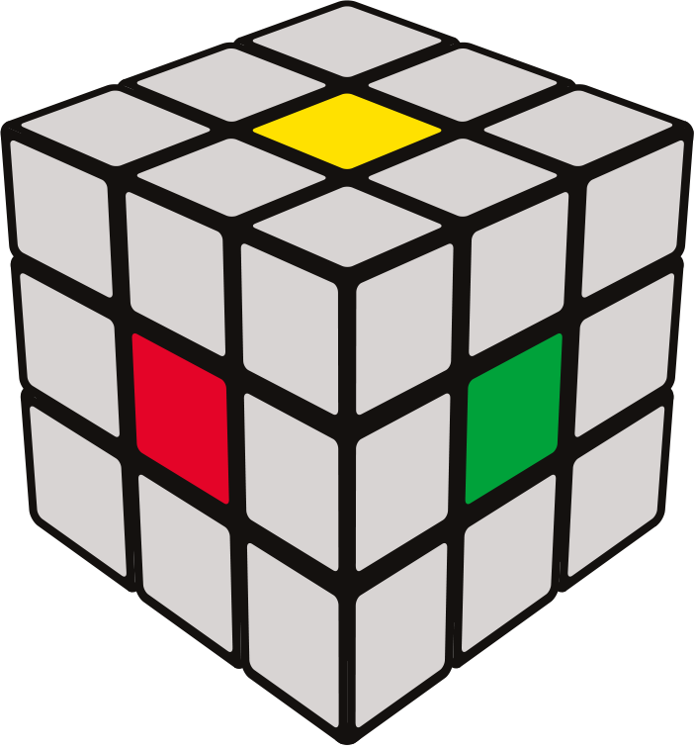
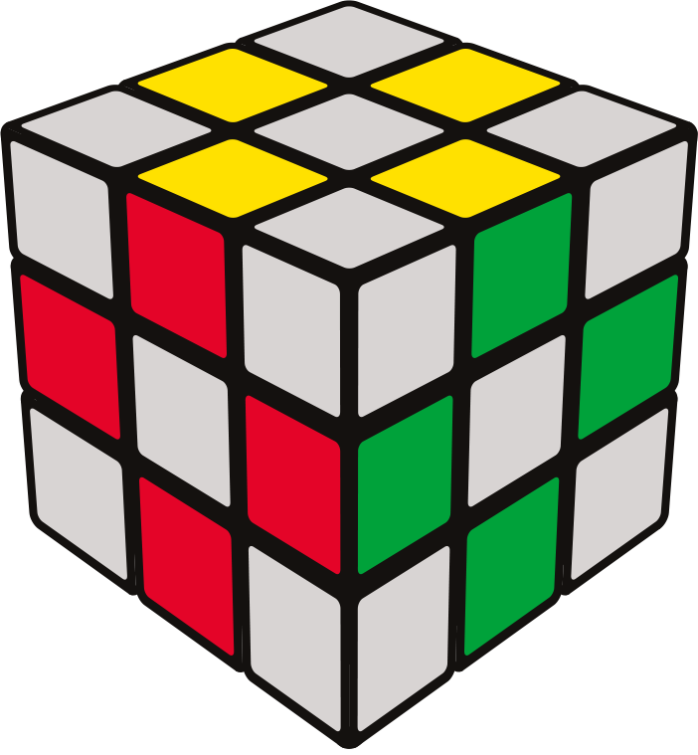
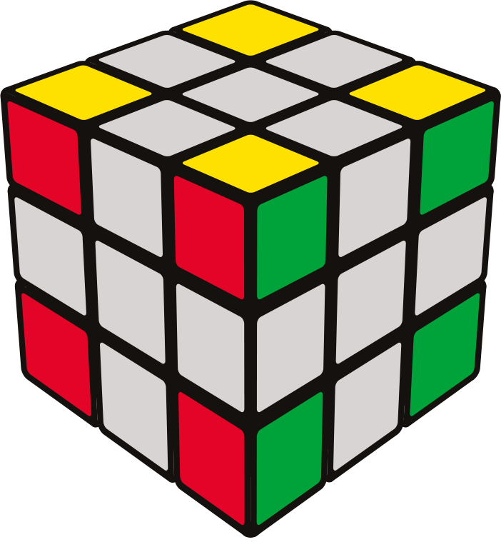
Introduction
4
Centers
Each of the six faces are defined by their own centres.
White centre is opposite of yellow, blue is opposite green and hence, red is opposite of orange.
Edges
There are 12 edges in a cube
Each edge piece has two coloured tiles.
Corners
There are 8 corner pieces in a cube
Each corner piece has three coloured tiles.

Slide 5
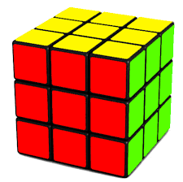
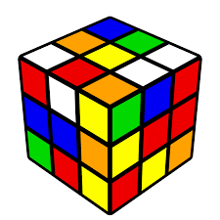
Introduction
5
Each face of a Rubik’s cube is represented by a letter.
R – Right face U – Upward face
L – Left face D – Downward face
B – Back face F – Front face
Unscrambled Rubik’s Cube
Unscrambled Rubik’s Cube
Scrambled Rubik’s Cube
Scrambled Rubik’s Cube

Slide 6
Motivation
6
The reason for choosing Rubik’s cube is because of its vast usage.
It is significant in the field of Mathematics and Artificial Intelligence.
It is capable to form complex counting equations while studying permutations & combinations.
It is also popularly used for testing, training, and developing new or improved existing Artificial Intelligence models & algorithms.

Slide 7
Related Work
7
Rubik’s Cube is a very popular mechanical puzzle & it is widely used for scientific research & development
Many scholars are working to find an optimal solution to solve it using various mathematical approaches & modern era technologies like Deep Neural Networks, Robotics, Intelligent Systems etc..
The four most important approaches are the work of Thistlethwaite's, Kociemba's, Rokicki’s & Korf’s.
Their advanced algorithms are based on advanced concepts like Iterative Deep Searching combined with A*)
There are many research papers in famous international journals which focus on study & development of an optimized algorithm for solving it & to find the God’s Number for the cube

Slide 8


Proposed Method
8
Testing & Development Environment
Programming Language: C++
Version ISO/IEC 14882:2020 OR C++20
Operating System
Microsoft Windows 10 Home
Version: 21H1
Build: 19042.1110
Bit speed: 64bit
Notes:
For testing and development environment, we will be using C++ version 14882 that was released in 2020. On Microsoft Windows 10, 64 bit with the latest version 21H1.

Slide 9



Proposed Method
9
Integrated Development Environment
Why?
Inbuilt Debugger
Inbuilt Application Profiling
Inbuilt Storage Visualization
Inbuilt CPU usage Visualization
Inbuilt GIT Integration
Inbuilt Live Team Collaboration
Microsoft Visual Studio 2019 Community
Build Version: 16.11
Extension: Desktop development with C++
Notes:
For Ide we will be using Microsoft visual studio, version 2019, community edition with “Desktop development with C++” extension enabled. It is an advanced windows development tool made by Microsoft in early 90s and kept upgrading it till now. We chose Microsoft Visual studio because of it’s very useful inbuilt features like, Debugger, Profiler, Storage, CPU, GPU visualiser, git integration, live team collaboration and many more.

Slide 10
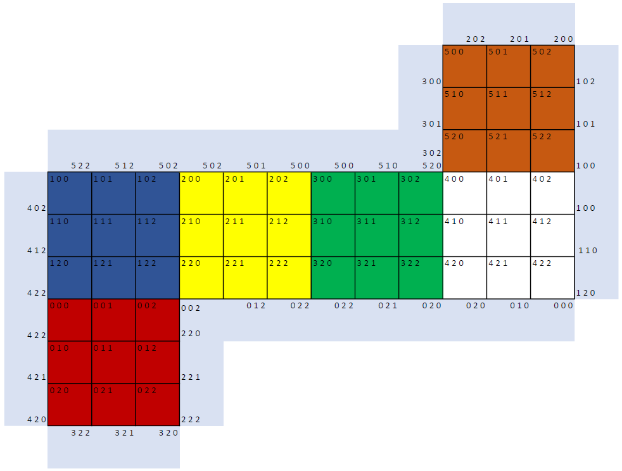
Proposed Method
Representation of cube
Red | 0
Blue | 1
Yellow | 2
Green | 3
White | 4
Orange | 5
Array[6][3][3]
Notes:
For representation of the cube in our codes we will be using a 3 dimensional integer array of size 6x3x3, as 6 faces, length & breadth. The index of each cell of a cube is shown in the figure. Colors of the cells will be stored in the array in the form of integers ranging from 0 to 5 for red, blue, yellow, green, white & orange respectively.

Slide 11
Proposed Method
Solving Algorithms
Scrambling Algorithm
Markov-chain Algorithm
1. Kociemba’s Algorithm
3. Tomas Rokicki’s Algorithm
2. Korf’s Algorithm
4. Thistlehwaite’s Algorithm
Testing Parameters
1. No. of Moves
2. Time Complexity
3. Space Complexity
4. Line of Code
Notes:
We have chosen 4 most important cube solving algorithms which are Kociemba’s, Korf’s, Tomas Rokicki’s & Thistlewaite’s algorithm. For Scrambling of the cube we will be using Markov-chain Algorithm as it decreases the probability of repetition of a solving move with every scrambling move. For testing and analysis we will be ranking all 4 algorithm on the basis of No. of moves it takes to solve the cube, Time taken by the algorithm to find the optimal solution, storage space taken by the algorithm and no. of lines of code the algorithm has taken.

Slide 12
Methodology
12
Study the working of all the algorithms
Write the code of all algorithms
Study and code Markov-Chain algorithm
Merge all the algorithms and scrambling algorithm
Analyze all the algorithms
Make project report

Slide 13
Plan of Work
13
Project Timeline
Date | Expected Work
1st September 2021 - 15th September 2021 | Study of all the four algorithms
16th September 2021 - 30th September 2021 | Study Markov Chain algorithm and code all the algorithms
1st October 2021 - 20th October 2021 | Completion of code of all algorithms and merging algorithms with each other
21st October 2021 – 10th November 2021 | Analysis of all algorithms and preparing report.

Slide 14
References
14
[1] https://theconversation.com/how-hard-is-it-to-scramble-rubiks-cube-129916
[2]https://www.researchgate.net/publication/220867821_An_Evolutionary_Approach_for_Solving_the_Rubik's_Cube_Incorporating_Exact_Methods
[3] https://d4mucfpksywv.cloudfront.net/papers/solving-rubiks-cube.pdf
[4] https://cjme.springeropen.com/articles/10.1186/s10033-018-0269-7
[5] https://personal.math.ubc.ca/~cass/courses/m308/projects/rtran/rtran.pdf
[6]https://www.researchgate.net/publication/220867821_An_Evolutionary_Approach_for_Solving_the_Rubik's_Cube_Incorporating_Exact_Methods
[7] https://d4mucfpksywv.cloudfront.net/papers/solving-rubiks-cube.pdf
[8] https://cjme.springeropen.com/articles/10.1186/s10033-018-0269-7
[9] https://medium.com/@benjamin.botto/implementing-an-optimal-rubiks-cube-solver-using-korf-s-algorithm-bf750b332cf9#:~:text=on%20my%20GitHub.-,Korf's%20Optimal%20Algorithm,is%20a%20tree%2Dtraversal%20algorithm.
[10] https://www.cubelelo.com/blogs/cubing/how-to-solve-rubiks-cube-in-20-moves

Slide 15




Team Details
S. No. | Student Name | Roll No. | SAP | Batch | Role
1 | Garvit Khurana | R177219080 | 500076532 | B. Tech. CSE spz. AI & ML Batch 3 Sem V | Developer & Version Control
2 | Tanya Malhotra | R177219191 | 500075815 | B. Tech. CSE spz. AI & ML Batch 6 Sem V | Developer & Documentation
3 | Utkarsh Gupta | R177219194 | 500075374 |  | Developer & Team Leader
4 | Vanshaj Goel | R177219196 | 500076419 |  | Developer & Researcher

Slide 16
Thank You
16
16

